Slide 1
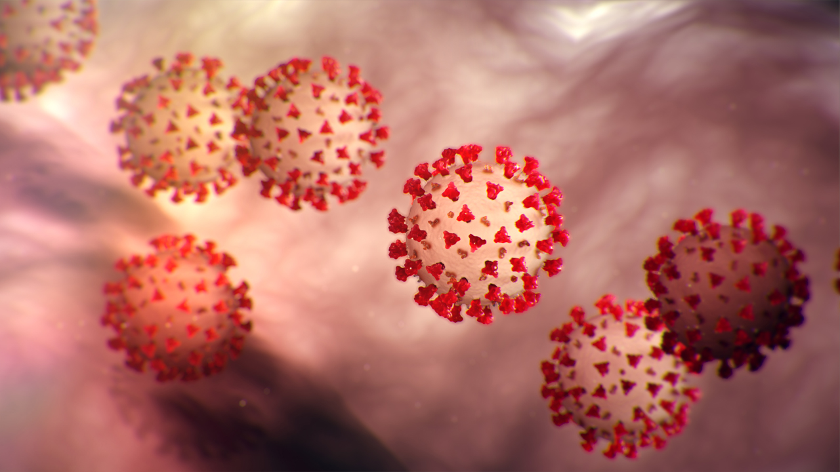
Coronavirus information

Slide 2
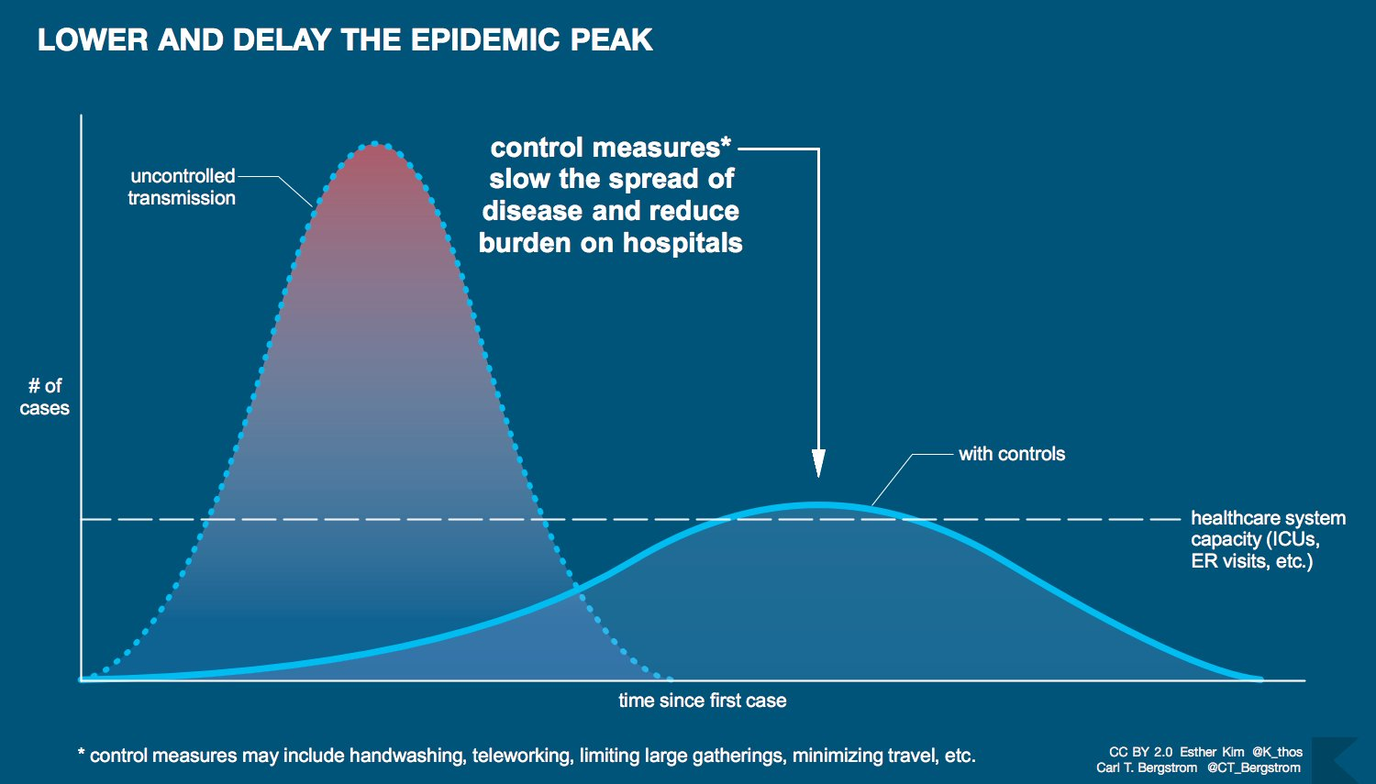

Slide 3
Learning Goals
Identify structural and functional adaptations contribute to prokaryotic success
Describe how rapid reproduction, mutation, and genetic recombination promote genetic diversity in prokaryotes
Explain ways prokaryotes can be beneficial or harmful to people

Slide 4
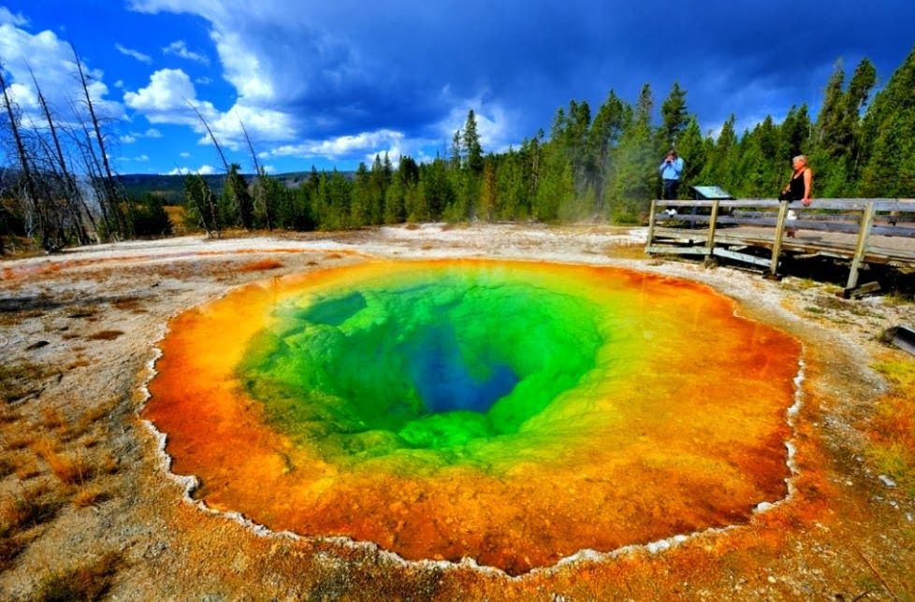
Bacteria and Archaea - Masters of Adaptation
Notes:
Hotspring in Yellowstone national park
The colors are different organisms living in this really hot environment
They are archaea

Slide 5
Bacteria and Archaea - Prokaryotes
The first organisms to live on Earth 3.5 billion years ago were prokaryotes
prokaryotes are still the most numerous organisms on Earth today
Some can survive and reproduce in environments:
with a pH of less than 1.0
So radioactive they would kill a person in days
So hot they would boil a person alive in minutes

Slide 6
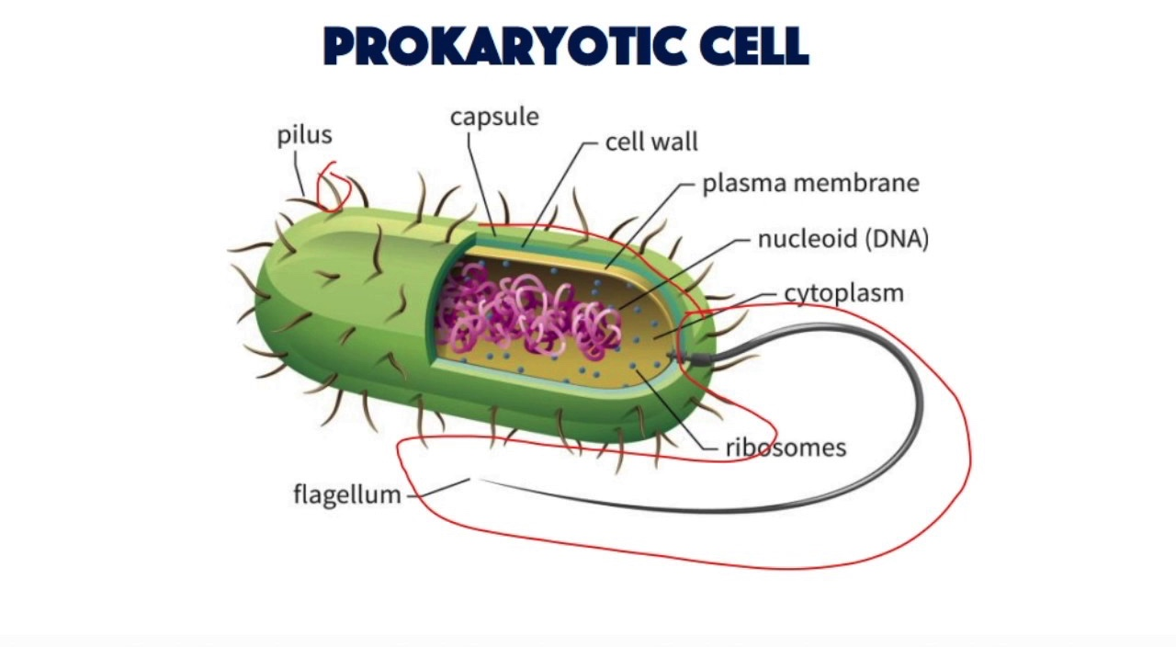
Review: Bacteria and Archaea are both lineages of prokaryotic organisms
Notes:
before true kernel (no nucleus)

Slide 7
Review: Bacteria and Archaea are both lineages of prokaryotic organisms
A prokaryote is a unicellular organism that lacks a membrane-bound nucleus, mitochondria, or other membrane-bound organelles.
Prokaryotes are divided into two domains, Archaea and Bacteria

Slide 8
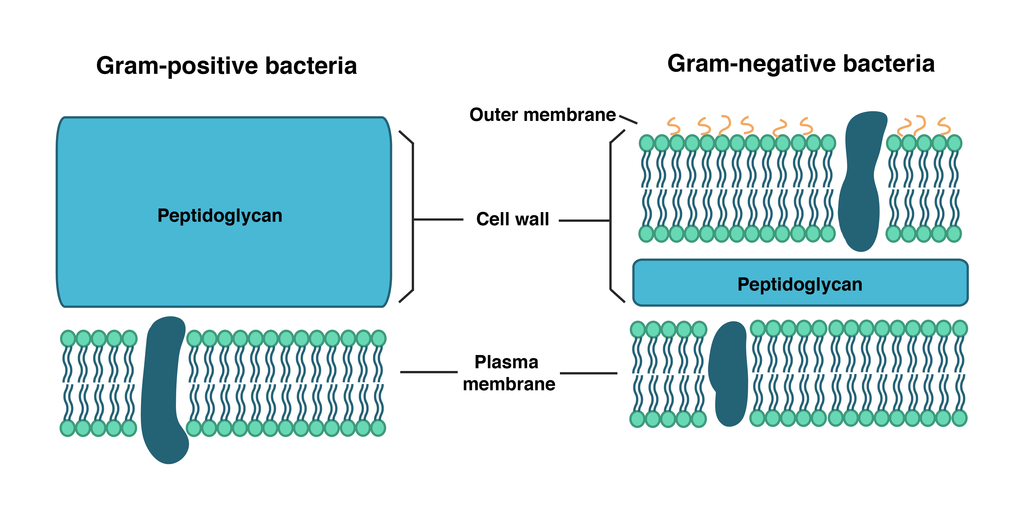
Structural and functional adaptations contribute to prokaryotic success
1. Cell surface structures
Bacteria have cell walls containing peptidoglycan
Notes:
Peptidoglycan is a matrix of sugars linked with amino acids
Archaea have a similar cell wall but it is built a little differently

Slide 9
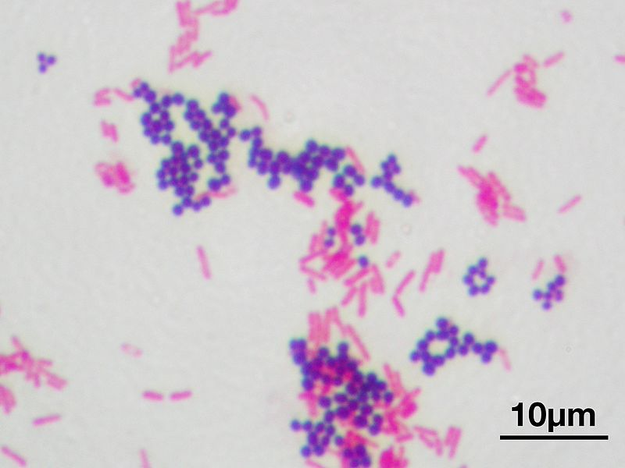
Structural and functional adaptations contribute to prokaryotic success
A Gram stain binds to peptidoglycan. Bacteria can be classified as gram positive or gram negative.
Notes:
Purple = gram positive
Pink = gram negative

Slide 10
Structural and functional adaptations contribute to prokaryotic success
The cell wall is often surrounded by a sticky mix of protein and polysaccharide called a capsule
Allows the prokaryote to adhere to a surface or to other prokaryotes in a colony

Slide 11
Structural and functional adaptations contribute to prokaryotic success
Some bacteria can also build a protective layer called an endospore to survive harsh or unfavorable conditions in a dormant state

Slide 12
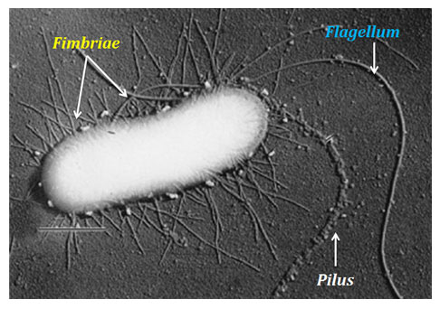
Structural and functional adaptations contribute to prokaryotic success
Fimbria - small hair-like projections that allow bacteria to stick to surfaces or other cells

Slide 13
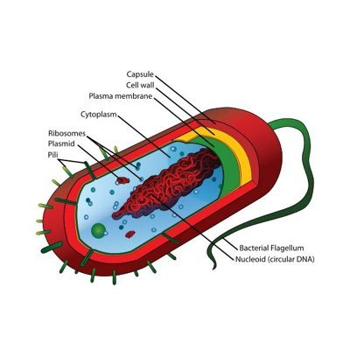
Structural and functional adaptations contribute to prokaryotic success
2. Motility
flagella - a tail-like appendage that enables the to swim through fluid
Notes:
Archaea and bacteria have flagella that have the same function but different ways of working

Slide 14
Structural and functional adaptations contribute to prokaryotic success
3. Reproduction
Prokaryotes are able to reproduce through binary fission
Capacity for rapid population growth under favorable conditions

Slide 15
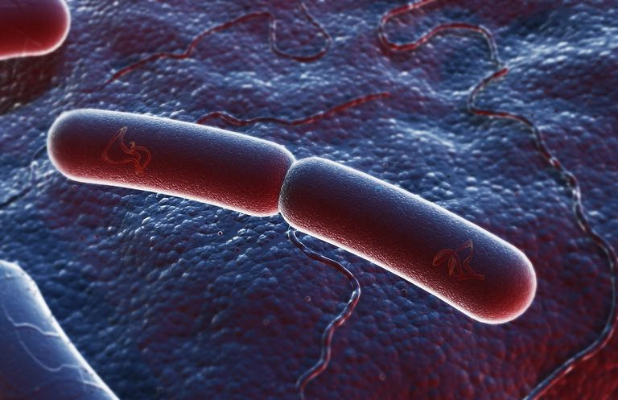
True or false, and why?: If an organism reproduces by fission, all of their offspring are genetically identical. Therefore they are unable to adapt to new or changing conditions.
Notes:
false, mutations happen because of radiation and other mutagens, copying errors. Horizontal transmission through the use of plasmids.

Slide 16
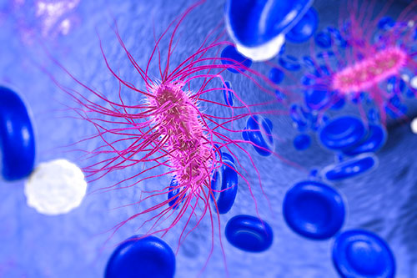
Rapid reproduction, mutation, and genetic recombination promote genetic diversity in prokaryotes
Prokaryotes undergo rapid reproduction and mutation

Slide 17
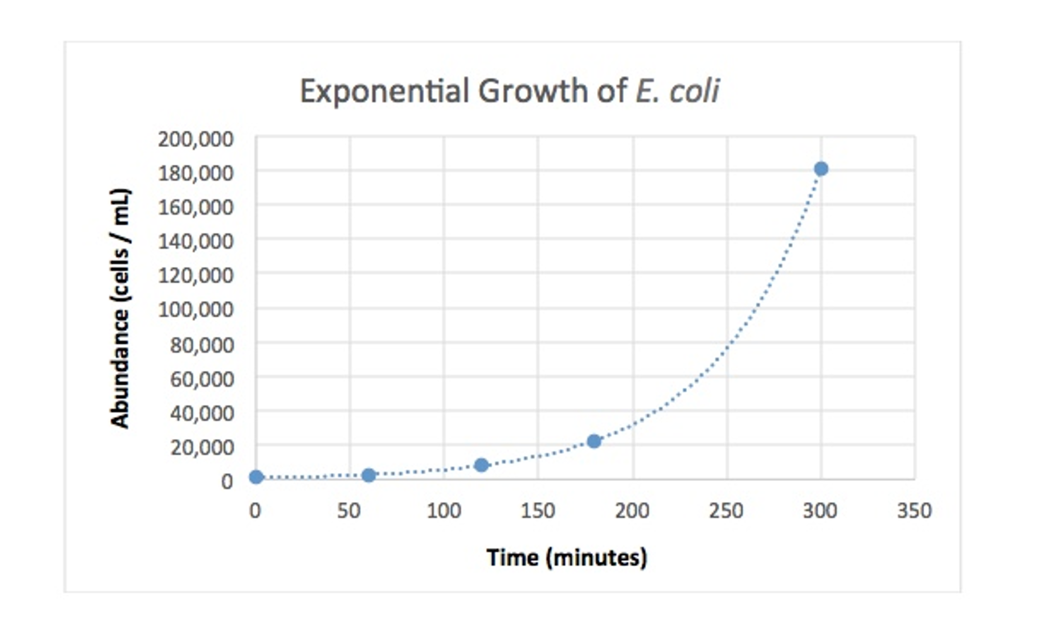
Rapid reproduction, mutation, and genetic recombination promote genetic diversity in prokaryotes

Slide 18
Rapid reproduction, mutation, and genetic recombination promote genetic diversity in prokaryotes
Probability of a mutation is one in 10 million per gene per division
Each day, 20 billion new E. coli cells arise in a person
E coli has about 4300 genes

Slide 19
Rapid reproduction, mutation, and genetic recombination promote genetic diversity in prokaryotes
8.6 million mutations per day in a single host
While mutations are rare on a per gene basis, they are common in large populations reproducing rapidly

Slide 20
Rapid reproduction, mutation, and genetic recombination promote genetic diversity in prokaryotes
Prokaryotes also undergo genetic recombination (mixing genes from multiple organisms into one genome)
prokaryotes combine genetic material with other organisms independent of reproduction, a process called horizontal gene transfer

Slide 21
Rapid reproduction, mutation, and genetic recombination promote genetic diversity in prokaryotes
mechanisms of horizontal gene transfer in prokaryotes
1. Transformation - A DNA fragment from a dead, degraded bacterium enters a living recipient bacterium and is exchanged for a piece of DNA of the recipient

Slide 22
Rapid reproduction, mutation, and genetic recombination promote genetic diversity in prokaryotes
mechanisms of horizontal gene transfer in prokaryotes
2. Transduction - viruses that infect bacteria and archaea (bacteriophages) transfer genes from one organism to another

Slide 23
Rapid reproduction, mutation, and genetic recombination promote genetic diversity in prokaryotes
mechanisms of horizontal gene transfer in prokaryotes
3. Conjugation - DNA is transferred between two prokaryotic cells, usually the same species, that become physically joined

Slide 24
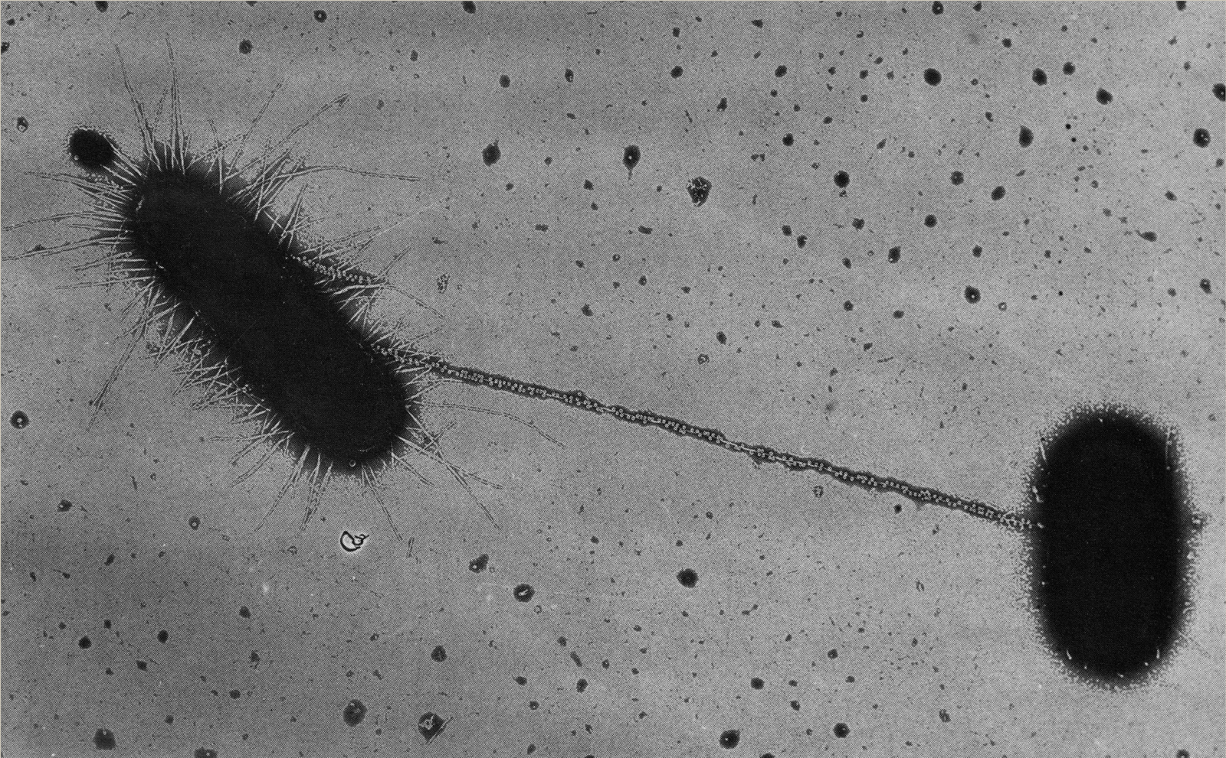
Rapid reproduction, mutation, and genetic recombination promote genetic diversity in prokaryotes
Conjugation - One cell extends a protein tube towards another cell, and attaches to it, like a grappling hook. It is a special type of fimbria, called a pillus.

Slide 25
Prokaryotes are both beneficial and harmful to people
Mutualists - species that benefit us, and we benefit them
Pathogens - species that harm us

Slide 26
Prokaryotes are both beneficial and harmful to people
Bacteria cause about half of all human diseases
Endotoxins - Contained inside the body of the bacteria (isn’t released if its alive)
Exotoxins – Secreted by living bacteria

Slide 27
Prokaryotes are both beneficial and harmful to people
Examples of industrial use of prokaryotes
Food Production
Environmental cleanup
Biotechnology
Cloning
Production of vitamins, hormones, antibiotics

